Slide 1
— Lectorial 9 Decision Trees and Random Forests
Machine Learning @ RMIT

Slide 2
We looked at Decision Trees:
Advantages:
Highly interpretable
Works really well on certain data sets
Problems with Decision Trees:
Not all the features are used in the model. The Information Gain metric or the Gini Index decides the
features to be included in your model.
Given a set of splitting rules (max depth of tree, splitting criterion (information gain or Gini index), number
of terminal nodes etc.) we will always get the same tree
High Variance : If the data set is split to two parts and we train a model for each part using the decision
tree algorithm, most often the two models we get are different.

Slide 3
Example:
 | Pollution | Temp | Industry | Population | Wind | Rain | Wet.days
1 | 24 | 61.5 | 368 | 497 | 9.1 | 48.34 | 115
2 | 30 | 55.6 | 291 | 593 | 8.3 | 43.11 | 123
3 | 56 | 55.9 | 775 | 622 | 9.5 | 35.89 | 105
4 | 28 | 51 | 137 | 176 | 8.7 | 15.17 | 89
5 | 14 | 68.4 | 136 | 529 | 8.8 | 54.47 | 116
6 | 46 | 47.6 | 44 | 116 | 8.8 | 33.36 | 135
7 | 9 | 66.2 | 641 | 844 | 10.9 | 35.94 | 78
8 | 35 | 49.9 | 1064 | 1513 | 10.1 | 30.96 | 129
9 | 26 | 57.8 | 197 | 299 | 7.6 | 42.59 | 115
10 | 61 | 50.4 | 347 | 520 | 9.4 | 36.22 | 147
11 | 29 | 57.3 | 434 | 757 | 9.3 | 38.98 | 111
12 | 28 | 52.3 | 361 | 746 | 9.7 | 38.74 | 121
13 | 14 | 51.5 | 181 | 347 | 10.9 | 30.18 | 98
14 | 18 | 59.4 | 275 | 448 | 7.9 | 46 | 119

Slide 4
15 | 17 | 51.9 | 454 | 515 | 9 | 12.95 | 86
16 | 23 | 54 | 462 | 453 | 7.1 | 39.04 | 132
17 | 47 | 55 | 625 | 905 | 9.6 | 41.31 | 111
18 | 13 | 61 | 91 | 132 | 8.2 | 48.52 | 100
19 | 31 | 55.2 | 35 | 71 | 6.6 | 40.75 | 148
20 | 12 | 56.7 | 453 | 716 | 8.7 | 20.66 | 67
21 | 10 | 70.3 | 213 | 582 | 6 | 7.05 | 36
22 | 110 | 50.6 | 3344 | 3369 | 10.4 | 34.44 | 122
23 | 56 | 49.1 | 412 | 158 | 9 | 43.37 | 127
24 | 10 | 68.9 | 721 | 1233 | 10.8 | 48.19 | 103
25 | 69 | 54.6 | 1692 | 1950 | 9.6 | 39.93 | 115
26 | 8 | 56.6 | 125 | 277 | 12.7 | 30.58 | 82
27 | 36 | 54 | 80 | 80 | 9 | 40.25 | 114
28 | 16 | 45.7 | 569 | 717 | 11.8 | 29.07 | 123
29 | 29 | 51.1 | 379 | 531 | 9.4 | 38.79 | 164
30 | 29 | 43.5 | 669 | 744 | 10.6 | 25.94 | 137
31 | 65 | 49.7 | 1007 | 751 | 10.9 | 34.99 | 155
32 | 9 | 68.3 | 204 | 361 | 8.4 | 56.77 | 113
33 | 10 | 75.5 | 207 | 335 | 9 | 59.8 | 128
34 | 26 | 51.5 | 266 | 540 | 8.6 | 37.01 | 134
35 | 31 | 59.3 | 96 | 308 | 10.6 | 44.68 | 116
36 | 10 | 61.6 | 337 | 624 | 9.2 | 49.1 | 105
37 | 11 | 47.1 | 391 | 463 | 12.4 | 36.11 | 166
38 | 14 | 54.5 | 381 | 507 | 10 | 37 | 99
39 | 17 | 49 | 104 | 201 | 11.2 | 30.85 | 103
40 | 11 | 56.8 | 46 | 244 | 8.9 | 7.77 | 58
41 | 94 | 50 | 343 | 179 | 10.6 | 42.75 | 125

Slide 5
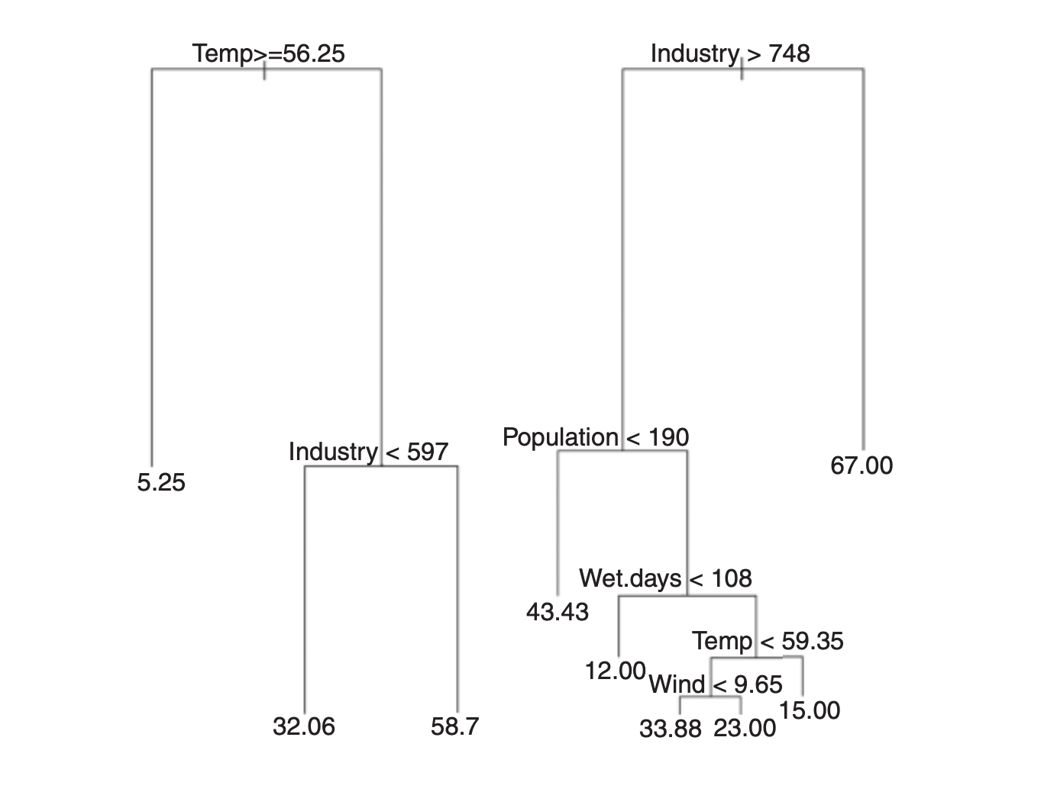

Slide 6
Training Data 1
Training Data 2
Training Data 3
Model 1
Model 2
Model 3
Prediction 3
(for a new data point)
Prediction1
(for a new data point)
Prediction 2
(for a new data point)
Final Model

Slide 7
Prediction1
(for a new data point)
Prediction2
(for a new data point)
Prediction 3
(for a new data point)
Y = 1
Y = 0
Y = 0
=
Y = majority(1, 0, 0)
So, Y = 0 for the new data point

Slide 8
Prediction1
(for a new data point)
Prediction2
(for a new data point)
Prediction 3
(for a new data point)
Y = 20
Y = 32
Y = 12
Y = average (20, 32, 12)
So, Y = 21.33
for the new data point

Slide 9
In real life we do not have multiple data sets for training.
So we use bootstrapping to make multiple sampling out of a single data set.
We use sampling with replacement for this.
3 20 5 8 19
Sample 1 - 20 8 20 3 19
Sample 2 - 8 8 3 3 20
Sample 3 - 19 3 20 5 5

Slide 10
Trees are allowed to grow full length (no pruning used in software)
Individual trees have high variance and low bias, averaging reduces the variance
Since at each subsampling of feature variables to be used in models, all features can be used,
thus yielding a different root node
In regression we average the predicted values from each tree
In classification problems, we take the majority vote. Target level voted most times is taken as the
final predicted level.

Slide 11
Check out how Python uses the Decision Tree Classifier and the
Random Forest Classfier.
class sklearn.tree.DecisionTreeClassifier(……. )
class sklearn.ensemble.RandomForestClassifier( ….)
How many trees to be included
How many feature variables to be included
Bootstrapping
Out of bag error

